Slide 1


Introduction to Cyberspace Security
网络空间安全导论
Lecture 5: Computer Networks and Network Security
– Layered Architecture; Network Verification
第5讲 计算机网络与安全 – 网络分层架构；网络验证
Instructor：Qiao Xiang
Oct. 14, 2022

Slide 2
Outline
Recap
A brief introduction to the Internet
past (a brief history)
present
Layered architecture
Network verification
This deck of slides are heavily based on CPSC 433/533 and CPSC 434/534 at Yale University, by courtesy of Dr. Y. Richard Yang, and the conference slides of " A General Approach to Network Configuration Verification", from Dr. Ryan Beckett.
2

Slide 3
Recap
A protocol defines the format and the order of messages exchanged between two or more communicating entities, as well as the actions taken on the transmission or receipt of a message or other events.
Key Internet milestones and their implications:
ARPANET is sponsored by ARPA
The initial IMPs (routers) were made by a small company
Many networks
Commercialization
design should survive failures
keep the network simple
internetworking: need a network to connect networks
architecture supporting decentralized, autonomous systems
3

Slide 4
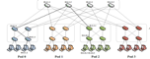
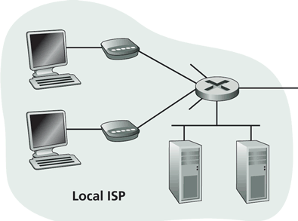
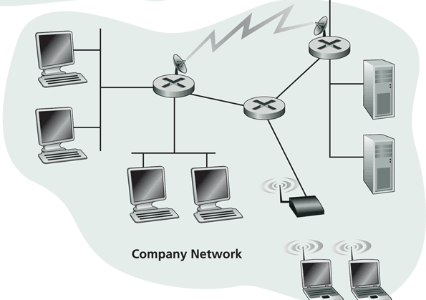
Recap: Internet Physical Infrastructure
Residential access
Cable, Fiber, DSL, Wireless
ISP
Backbone ISP
ISP
The Internet is a network of networks
Each individually administrated network is called an Autonomous System (AS)
data center
Campus access, e.g.,
Ethernet
Wireless
4

Slide 5
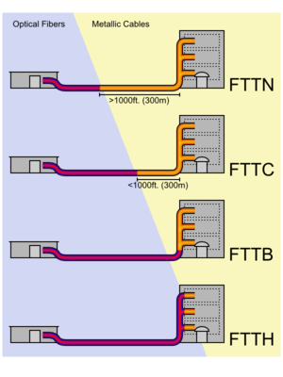
Access: Fiber to the x
http://en.wikipedia.org/wiki/Fiber_to_the_x
5

Slide 6
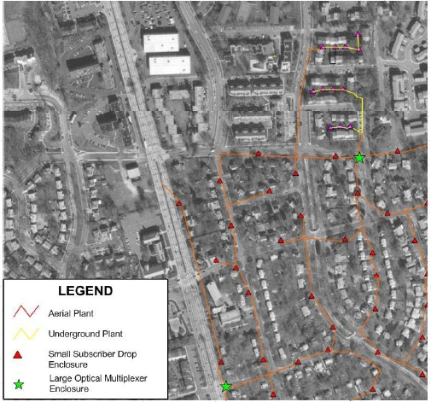
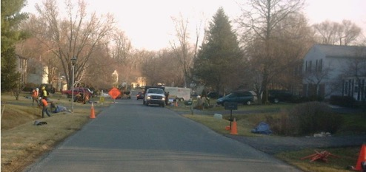
Access: Fiber to the Premises (FTTP)
Deployed by Verizon, AT&T, Google，
One of the largest comm. construction projects
6

Slide 7
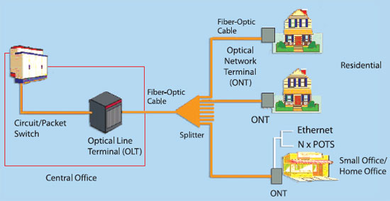
FTTP Architecture
7

Slide 8
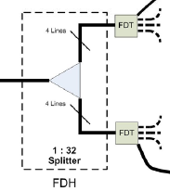
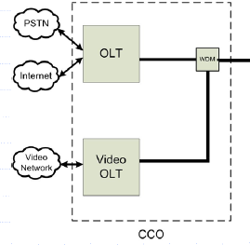
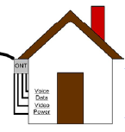
FTTP Architecture
Optical Network Terminal (ONT) box outside dwelling or business
Fiber Distribution Terminal (FDT) in poles or pedestals
Fiber Distribution Hub (FDH) at street cabinet
Optical Line Terminal (OLT) at central office
8

Slide 9
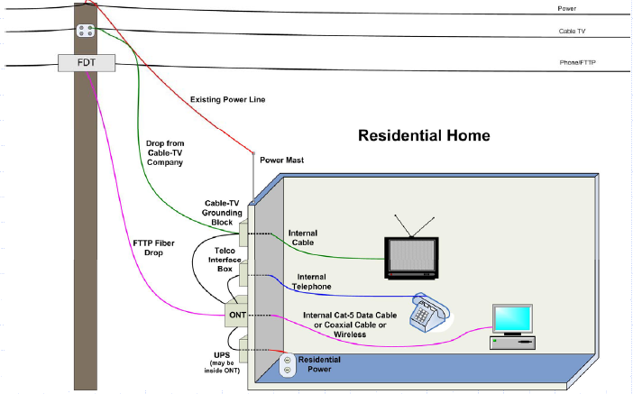
FTTP Architecture: To Home
9

Slide 10
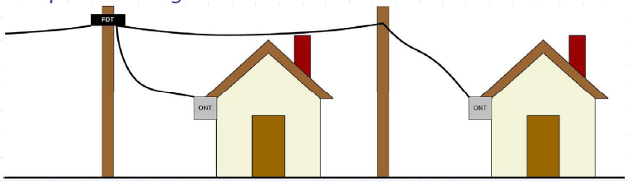
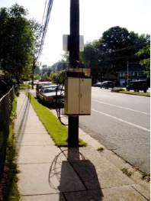
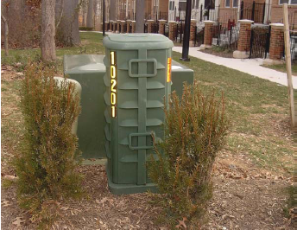
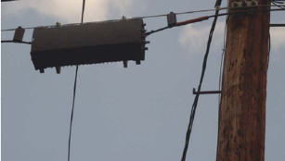
FTTP Architecture: Fiber Distribution Terminal (FDT)
10

Slide 11
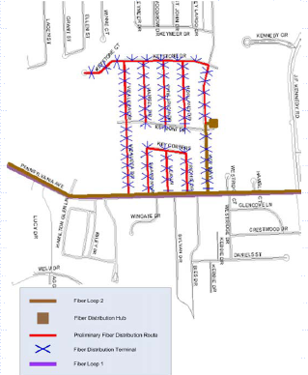
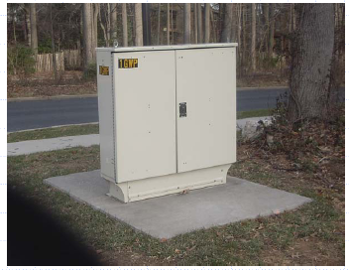
FTTP Architecture: Central to Fiber Distribution Hub (FDH)
- Backbone fiber ring on
primary arterial streets
(brown)
- Local distribution fiber
plant (red) meets backbone
at cabinet
11

Slide 12
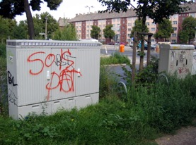
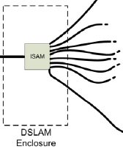
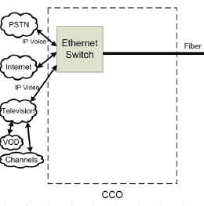
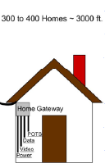
FTTP Architecture: Fiber Distribution Terminal (FDT)
Compared with FTTP, copper from cabinet (DSLAM) to home
DSLAM
12

Slide 13

Access: Wireless
https://x.company/loon/
13

Slide 14
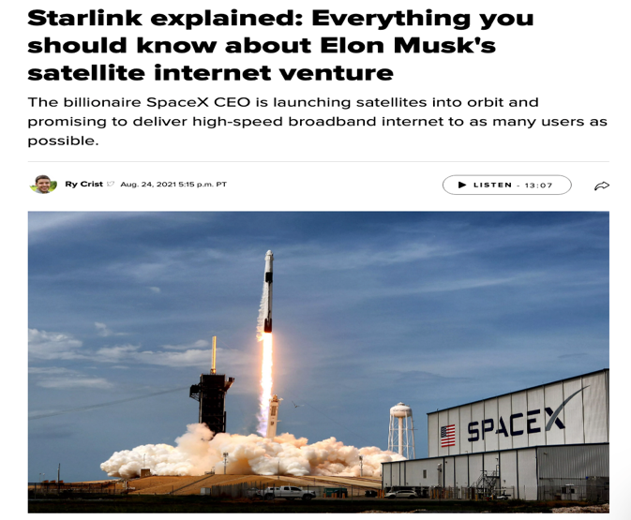
Access: Wireless
14
https://www.cnet.com/home/internet/starlink-satellite-internet-explained/

Slide 15

Campus Network
Internet
CE
F2
F1 (Firewall)
R1
S2
S1
LB2
LB1 (Load balancer)
IPS3
IPS2
IPS1 (Intrusion prevention)
S5
S4
S3
tier-1
VLAN 200
VLAN 100
VLAN 300
VLAN 400
Logger
Tier-3
Tier-2
Tier-1
15
15

Slide 16
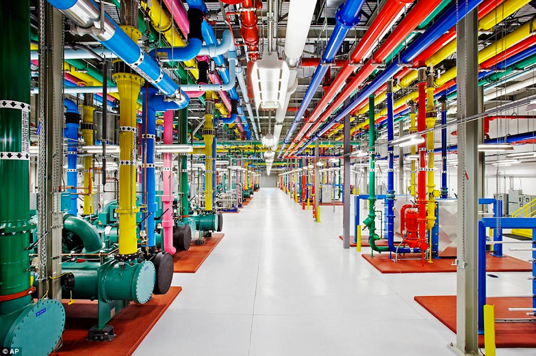
Data Center Networks
http://www.dailymail.co.uk/sciencetech/article-3369491/Google-s-plan-world-Search-engine-build-half-billion-dollar-data-center-US.html
16

Slide 17
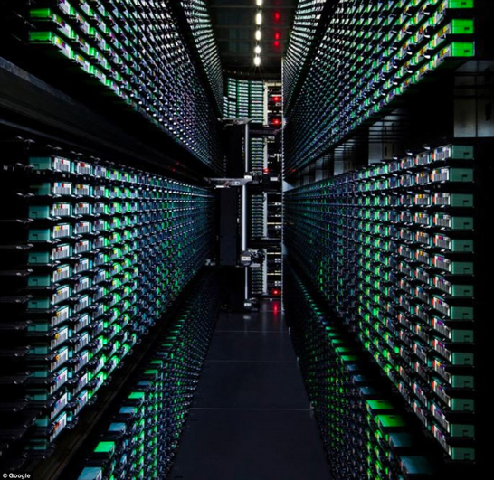
Data Center Networks
http://www.dailymail.co.uk/sciencetech/article-3369491/Google-s-plan-world-Search-engine-build-half-billion-dollar-data-center-US.html
17

Slide 18
Foundation of Data Center Networks
1
2
n
1
2
n
18

Slide 19
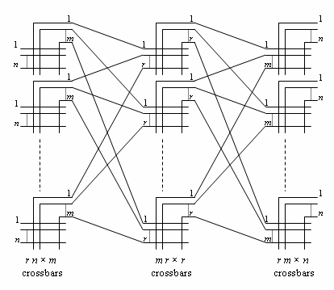
Foundation of Data Center Networks: Clos Networks
Q: How big is m so that each new call can be established w/o moving current calls?
Challenge to the class: If you can move existing calls, it is only m >= n.
https://en.wikipedia.org/wiki/Clos_network
19

Slide 20
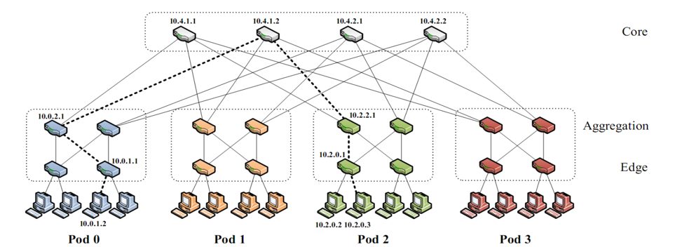
Data Center Networks:
Fat-tree Networks
K-ary fat tree: three-layer topology (edge, aggregation and core)
k pods w/ each pod consists of (k/2)2 servers & 2 layers of k/2 k-port switches
each edge switch connects to k/2 servers & k/2 aggr. switches
each aggr. switch connects to k/2 edge & k/2 core switches
(k/2)2 core switches: each connects to k pods
20
https://en.wikipedia.org/wiki/Clos_network
Q: How large a network can k-ary support using k-port switches?

Slide 21
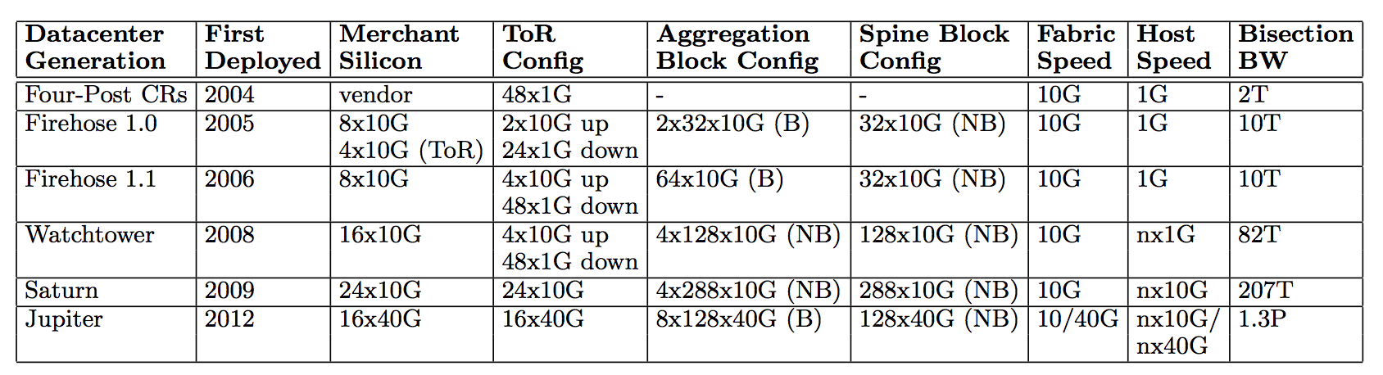
Data Center Networks:
For example, Google Jupiter at 1 Pbits/sec bisection bw: 100,000 servers at 10G each
http://googlecloudplatform.blogspot.com/2015/06/A-Look-Inside-Googles-Data-Center-Networks.html
http://conferences.sigcomm.org/sigcomm/2015/pdf/papers/p183.pdf
21

Slide 22
Recall: Internet Physical Infrastructure
Residential access
Cable, Fiber, DSL, Wireless
ISP
Backbone ISP
ISP
The Internet is a network of networks
Each individually administrated network is called an Autonomous System (AS)
data center
Campus access, e.g.,
Ethernet
Wireless
22

Slide 23
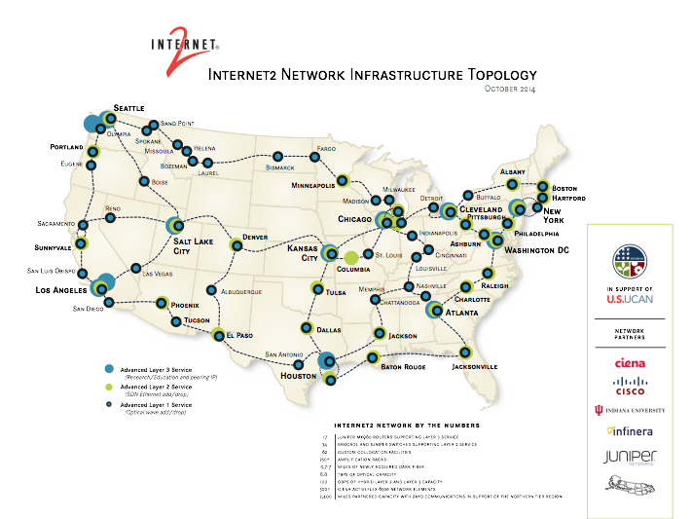
Internet2
http://noc.net.internet2.edu/i2network/maps-documentation/maps.html#Internet2 Combined Infrastructure Network Map
23

Slide 24
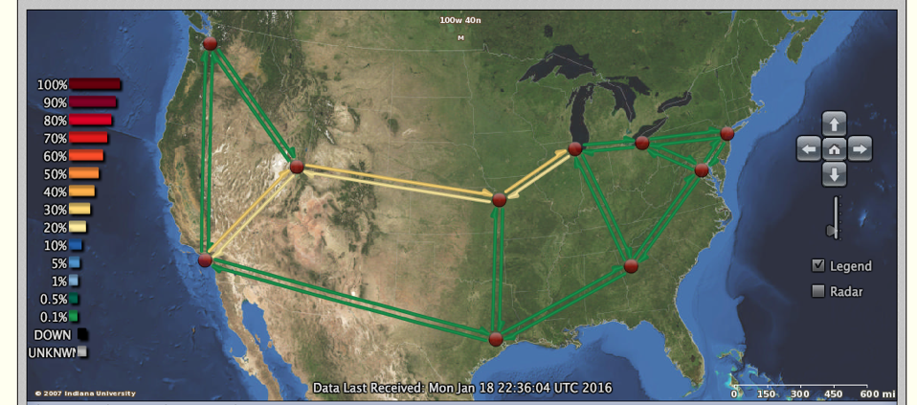
Internet2
http://atlas.grnoc.iu.edu/atlas.cgi?map_name=Internet2%20IP%20Layer
24

Slide 25
XMU Internet Connection
Try traceroute from XMU to
www.microsoft.com
www.baidu.com
www.sina.com.cn
www.taobao.com
25

Slide 26
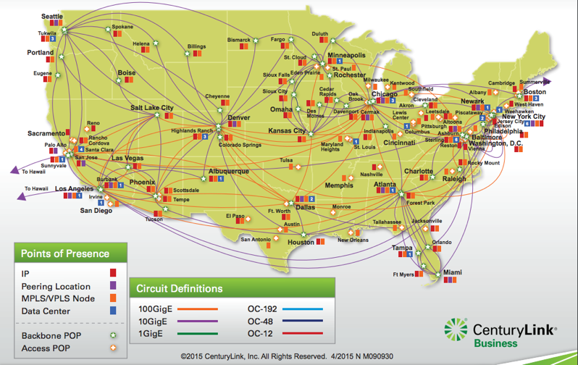
Qwest (CentryLink) Network Maps
Qwest Backbone Map
http://www.centurylink.com/business/asset/network-map/ip-mpls-network-nm090930.pdf
http://www.centurylink.com/business/resource-center/network-maps/
26

Slide 27
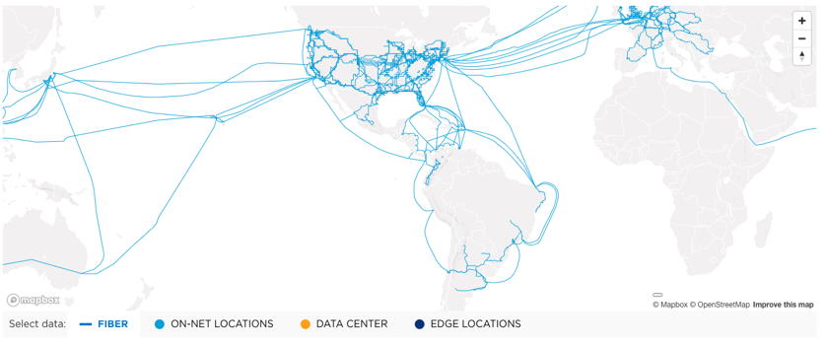
Level3 (now part of LUMEN) Network Map
https://www.lumen.com/en-us/resources/network-maps.html
27

Slide 28
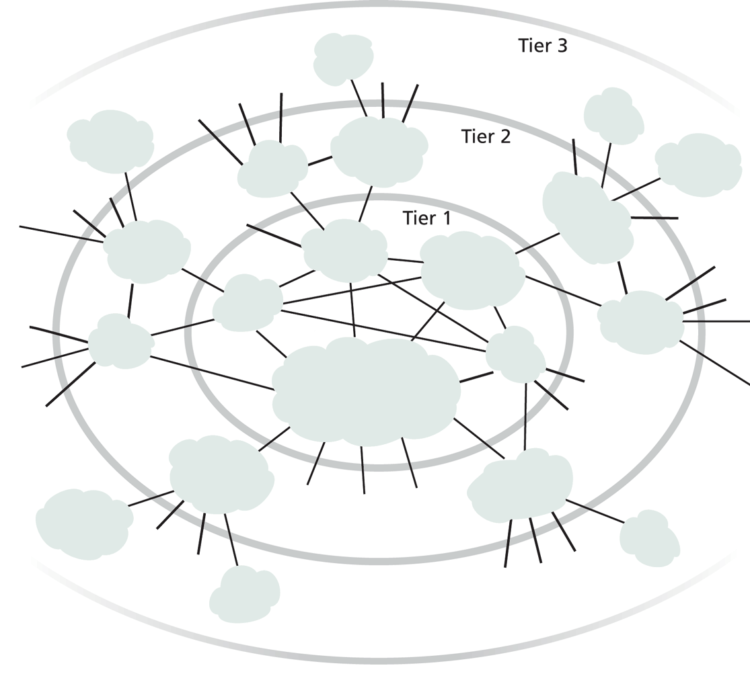
XMU Internet Connection
Roughly hierarchical
Divided into tiers
Tier-1 ISPs are also called backbone providers, e.g., AT&T, Verizon, Sprint, Level 3, Qwest
An ISP runs (private) Points of Presence (PoP) where its customers and other ISPs connect to it
ISPs also connect at (public) Internet Exchange Point (IXP)
public peering
http://en.wikipedia.org/wiki/List_of_Internet_exchange_points_by_size
28

Slide 29
Outline
Self-introduction
Why study computer networks?
What is a network protocol?
A brief introduction to the Internet
past (a brief history)
present
topology
traffic
29

Slide 30
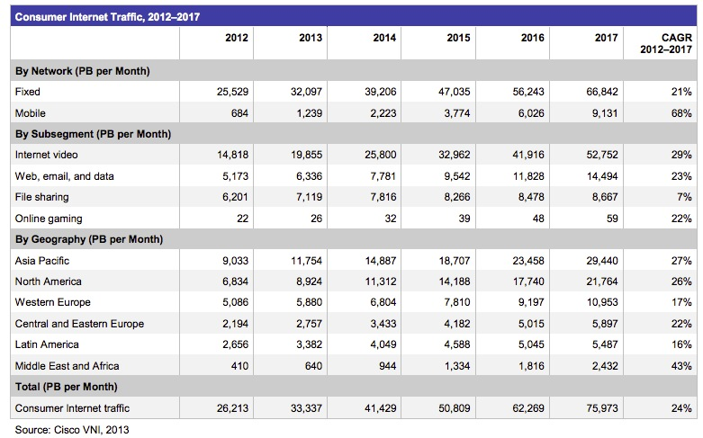
Internet (Consumer) Traffic
http://www.cisco.com/en/US/solutions/collateral/ns341/ns525/ns537/ns705/ns827/white_paper_c11-481360.pdf
30

Slide 31
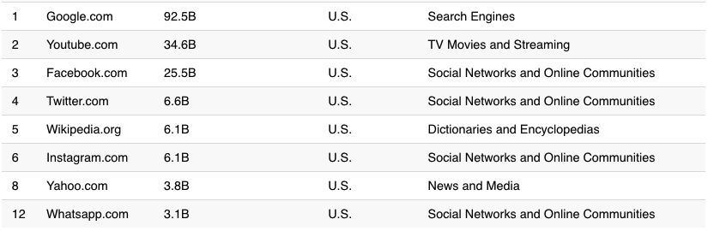
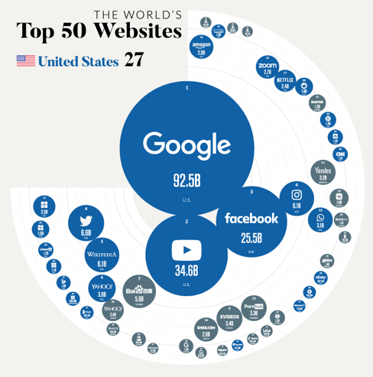
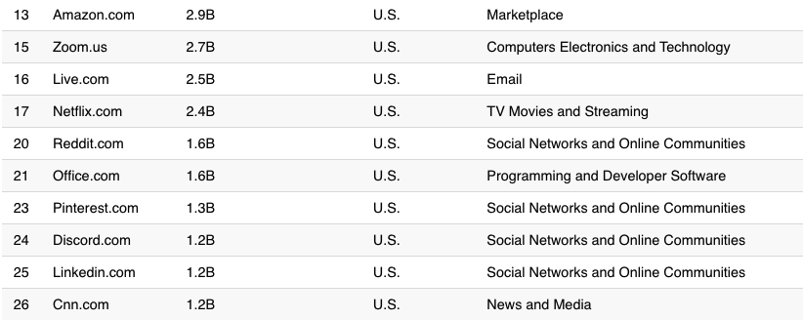
Largest Internet Sites in the World
https://www.visualcapitalist.com/wp-content/uploads/2021/01/Country-With-the-Most-Websites.html
Notes:
http://www.comscore.com/Insights/Press_Releases/2013/8/comScore_Media_Metrix_Ranks_Top_50_U.S._Web_Properties_for_July_2013

Slide 32
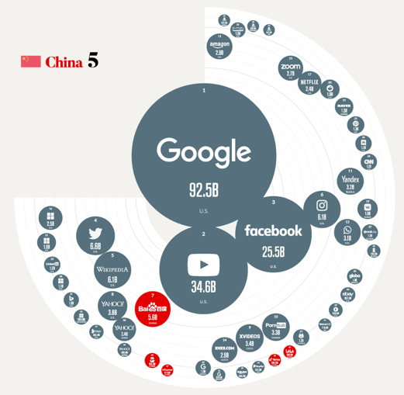
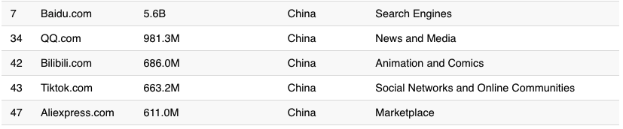
Largest Internet Sites in the World
https://www.visualcapitalist.com/the-50-most-visited-websites-in-the-world/

Slide 33
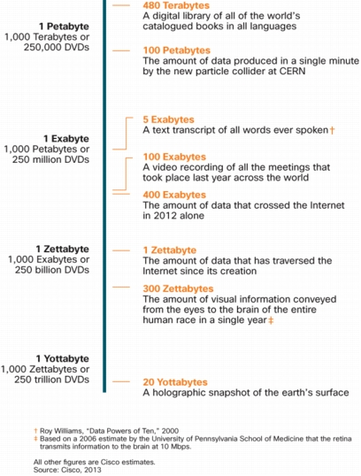

Internet Traffic in Perspective
640K ought to be enough for anybody.
33

Slide 34
What Will We Cover?
Network architecture and design principles
Layered network arch; e2e principle
Application architecture and design principles
application paradigms; high performance network app.
HTTP/Web, Email, DNS, P2P, Blockchain, Content distribution
Transport
transport services
reliability; distributed resource allocation; primal-dual
transport protocols: TCP/UDP
34

Slide 35
What Will We Cover?
Network and link layers
distributed, asynchronous, autonomous routing algorithms; scalable router design; IP/IPv6; mobile IP; cellular networks
multiple access; queueing analysis; capacity analysis
Next-generation network:
Cloud and data center design, programmable networks, RDMA
Physical layer
Wireless Networks
Network security
security primitives; BAN logic, SSL
35

Slide 36
Outline
Recap
A brief introduction to the Internet
Layered architecture
what is layering?
why layering?
ISO/OSI layering and Internet layering
36

Slide 37
What is Layering?
A technique to organize a networked system into a succession of logically distinct entities, such that the service provided by one entity is solely based on the service provided by the previous (lower level) entity.
Application
Application
Transport
Transport
Network
Network
Network
Datalink
Datalink
Datalink
Physical
Physical
Physical
Physical medium
37

Slide 38
Outline
Recap
Layered architecture
what is layering?
why layering?
38

Slide 39
Why Layering?
Networks are complex !
many “pieces”:
hardware
hosts
routers
links of various media
software
applications
infrastructure
Dealing with complex systems: explicit structure allows identification of the relationship among a complex system’s pieces
layered reference model for discussion
Modularization eases maintenance, updating of system:
change of implementation of a layer’s service transparent to rest of system, e.g., changes in routing protocol doesn’t affect rest of system
39

Slide 40
An Example: No Layering
Application
Telnet
FTP
HTTP
Transmission
Media
Ether-net
Fiber
optic
Wireless
No layering: each new application has to be re-implemented for every network technology !
40

Slide 41
An Example: Benefit of Layering
Introducing an intermediate layer provides a common abstraction for network technologies
Application
Telnet
FTP
HTTP
Transport
& Network
Transmission
Media
Ethernet
Fiber
optic
Wireless
41

Slide 42
ISO/OSI Concepts
ISO – International Standard Organization
OSI – Open System Interconnection
Service – says what a layer does
Interface – says how to access the service
Protocol – specifies how the service is implemented
a set of rules and formats that govern the communications between two or more peers
42

Slide 43
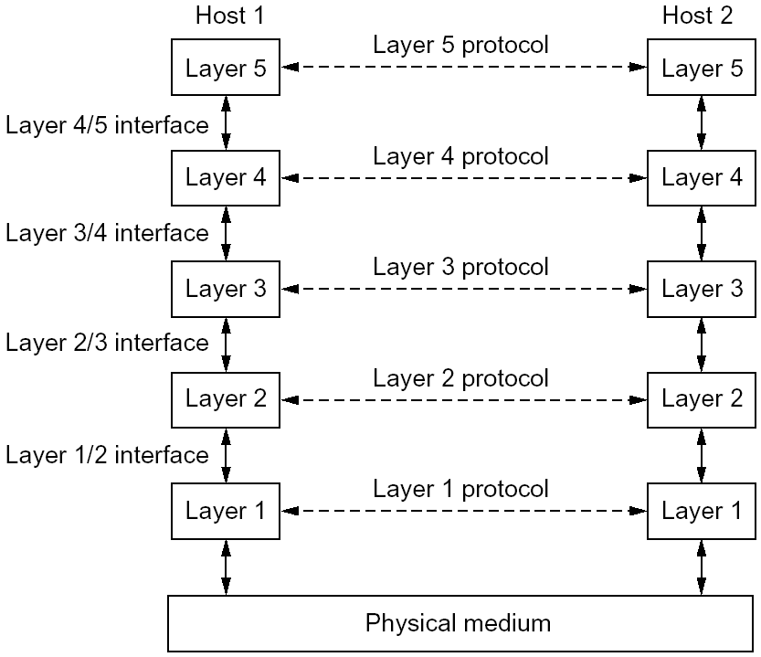
An Example of Layering
43

Slide 44
An Example of Layering
44

Slide 45
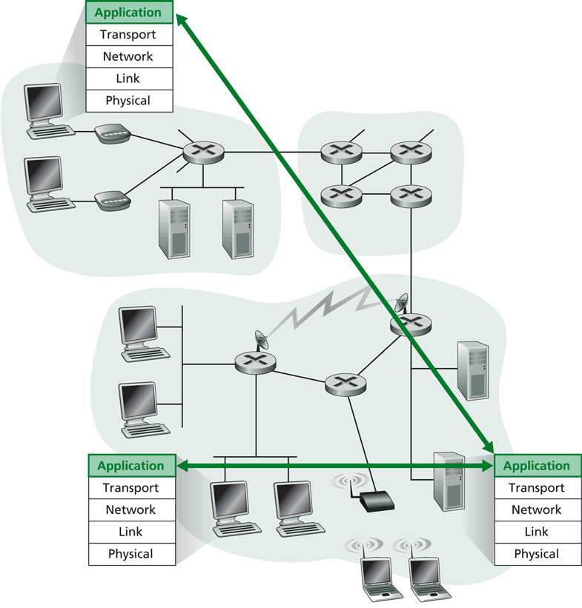
Layering -> Logical Communication
E.g.: application
provide services to users
application protocol:
send messages to peer
for example, HELO, MAIL FROM, RCPT TO are messages between two SMTP peers
45

Slide 46
Layering: Logical Communication
data
E.g.: transport
Trans. msg for app
Transport protocol
add control info to form “segment”
send segment to peer
wait for peer to ack receipt; if no ack, retransmit
application
transport
network
link
physical
transport
ack
network
link
physical
application
transport
network
link
physical
data
data
application
transport
network
link
physical
application
transport
network
link
physical
transport
46

Slide 47
Layering: Physical Communication
data
application
transport
network
link
physical
network
link
physical
application
transport
network
link
physical
data
application
transport
network
link
physical
application
transport
network
link
physical
47

Slide 48
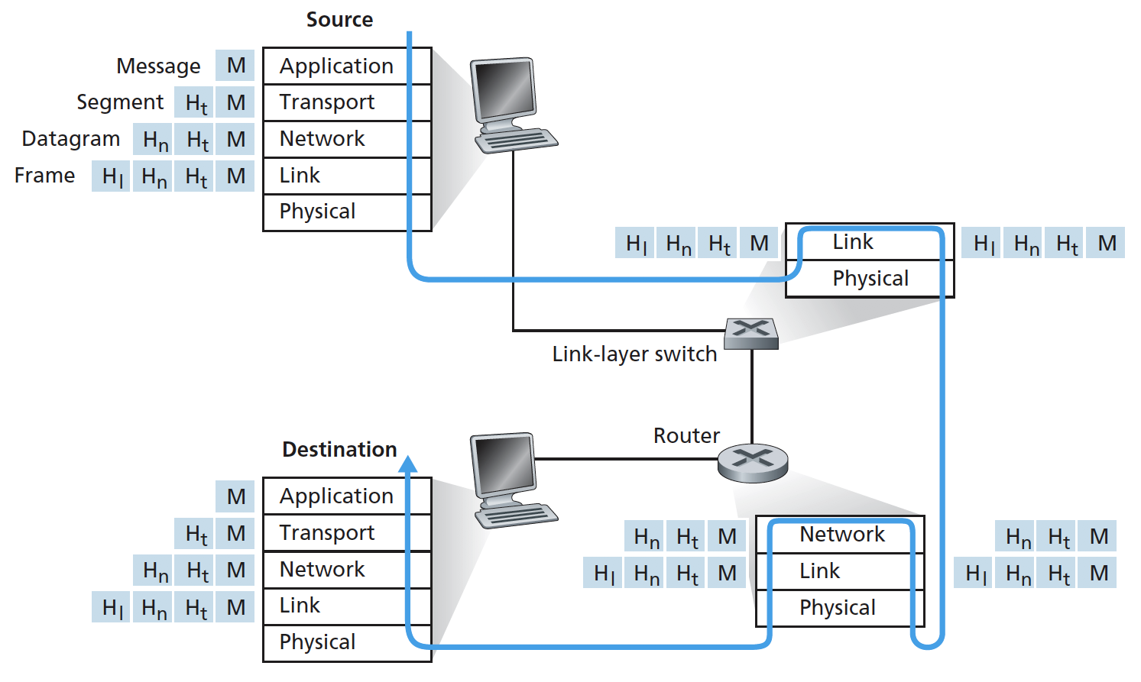
Protocol Layering and Meta Data
Each layer takes data from above
adds header (meta) information to its peer to create new data unit
passes new data unit to layer below
48

Slide 49
Packet as a Stack in a Layered Architecture
Application
Application
Transport
Transport
Network
Network
Network
Datalink
Datalink
Datalink
Physical
Physical
Physical
Physical medium
49

Slide 50
Some Implications of Layered Architecture
A packet as a stack container
Each layer needs multiplexing and demultiplexing to serve layer above
…
Hn-1
Hn
Ln
Has a field to indicate which higher layer requires the service
Ln-1
50

Slide 51
Outline
Recap
Layered architecture
what is layering?
why layering?
ISO/OSI layering and Internet layering
51

Slide 52
ISO/OSI Reference Model
Seven layers
highest four layers are implemented in host
Application
Application
Presentation
Presentation
Session
Session
Transport
Transport
Network
Network
Network
Datalink
Datalink
Datalink
Physical
Physical
Physical
Physical medium
52

Slide 53
Internet Layering
Five layers
highest two layers are implemented in host
Application
Application
Transport
Transport
Network
Network
Network
Datalink
Datalink
Datalink
Physical
Physical
Physical
Physical medium
53

Slide 54
Internet Protocol Layers
Five layers
Application: applications
ftp, smtp, http, p2p, IP telephony, blockchain, MapReduce, …
Transport: host-host data transfer
tcp (reliable), udp (not reliable)
Network: routing of datagram from source to destination
ipv4, ipv6
Link: data transfer between neighboring network elements
ethernet, 802.11, cable, DSL, …
Physical: bits “on the wire”
cable, wireless, optical fiber
application
transport
network
link
physical
54

Slide 55
The Hourglass Architecture of the Internet
Email
WWW
FTP
Telnet
TCP
UDP
end users
IP4
network
infrastructure
Ethernet
Wireless
Cable/DSL
55

Slide 56
Summary: The Big Picture of the Internet
Hosts and routers:
~ 1 bil. hosts
autonomous systems organized roughly hierarchical
backbone links at 100 Gbps
Software:
datagram switching with virtual circuit support at backbone
layered network architecture
use end-to-end arguments to determine the services provided by each layer
the hourglass architecture of the Internet
Email
WWW
FTP
Telnet
SSL
TCP
UDP
IP4/6
Ethernet
Wireless
Cable/DSL
56

Slide 57
Outline
Recap
Layered architecture
what is layering?
why layering?
ISO/OSI layering and Internet layering
Network Verification
57

Slide 58
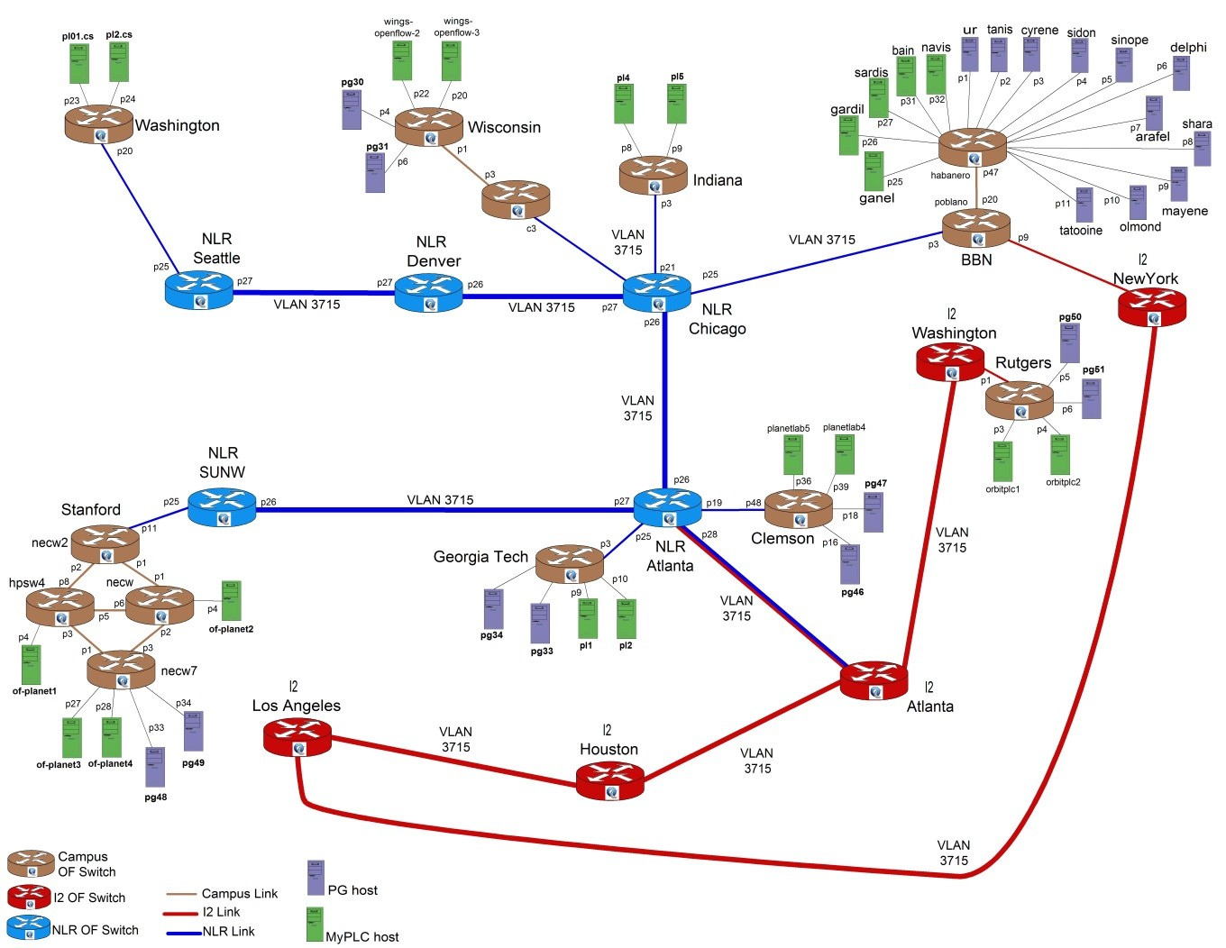
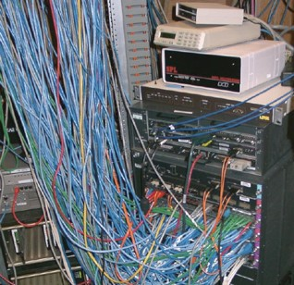
Setting
Source: http://groups.geni.net/geni/chrome/site/thumbnails/wiki/TangoGENI/OF-VLAN3715_1000.jpg
Modern networks are
increasingly more complex
outages increasingly more costly
58

Slide 59













Simple Example
Previously, an intrusion detection and prevention (IDP) device inspected all traffic to/from dorms
IDP couldn’t handle load; added bypass
IDP only inspected traffic between dorm and campus
Q: How do you know if it is acceptable?
dorm
IDP
…
bypass
Backbone
59

Slide 60
Discussion
How may you verify whether the behavior of a network (system) is acceptable?
60

Slide 61
Basic Correctness Properties
Reachability: two entities reach each other if and only allowed by policy
No want reach but does not reach
No loop
No blackhole
No want no reach but reach
No leakage among tenants
Constraints
Reachability only if pass a specified sequence of middleboxes
Consistency
Two nodes (e.g., mirrors) have exactly the same behavior
61

Slide 62
Basic Types of Approaches
Control Plane
Data Plane
execute
Data plane verification
Anteater
HSA
Veriflow
Atomic Predicates
…
Control plane verification
Batfish
Minesweeper
…
62

Slide 63




Data Plane Verification: Setting
Input: Each device has already computed its data plane (flow table)
Output: Verify that the network’s behavior satisfy given correctness properties
Destination Iface
10.1.1.0/24 & port = 80
Drop
10.1.1.128/25
v’
10.1.1.0/24
v
10.1.1.2
v
u
v
63

Slide 64
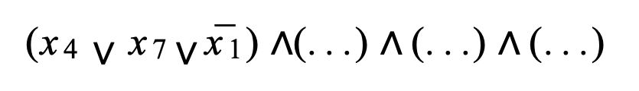
Network Verification can be Hard
Correctness (reachability): s cannot reach t
Network mechanism: assume flow table allows one-bit packet filters, e.g.,
Then: verify reachability is NP-Hard
“if p[43]
= 0 then
drop”
p[4] = 1
p[7] = 1
p[1] = 0
(x₄ $∨$ x₇ $∨$ x¯₁) $∧$(. . .) $∧$ (. . .) $∧$ (. . .)
64

Slide 65
Look Ahead
Despite theoretical hardness, much success in practical systems
65

Slide 66
Outline
Recap
Layered architecture
what is layering?
why layering?
ISO/OSI layering and Internet layering
Network Verification
Data plane verification - Anteater
66

Slide 67
Anteater
Among the first to apply formal method (Boolean satisfiability; SAT) to network verification
Model datapath correctness requirements as Boolean expressions
Verify network properties by computing Boolean Satisfiability (e.g., use SAT tool such as Boolector)
67

Slide 68
Two-Slide SAT
Input
Given a Boolean expression P(x₁, x₂, …., x_{n}), where each x_{i} is a Boolean variable (true, false)
Goal: find an assignment to x_{i} to make P(x₁, x₂, …., x_{n}) true, e.g.,
P(x, y) = x v y
P(x, y) = x ^ !x
Ex: what if you want to verify that P(x₁, x₂, …., x _{n}) is always true
Substantial progress in SAT solvers, typically based on an approach called “systematic search.”
68

Slide 69
“Systematic” SAT Search
The search space is a tree
each vertex representing a Boolean variable
out edges representing the two choices (true and false) for this variable.
The DPLL/Davis-Putnam-Logemann-Loveland algorithm
based on 3 operations: decide, propagate, and backtrack.
benefits from a restricted representation of formulas in conjunctive normal form, or CNF, e.g., ¬p ∧ (p ∨ q)
69

Slide 70
DPLL: An Simple Demonstration

Slide 71



DP as Boolean Expressions
Define P(u, v) as the policy function for packets traveling from u to v
A packet can flow over (u, v) if and only if it satisfies P(u, v)
Destination Iface
10.1.1.0/24 v
u v
P(u, v) = dst_ip ∈10.1.1.0/24
71

Slide 72



DP as Boolean Expressions: Simpler Example
Destination Iface
0.0.0.0/0 v
u
v
P(u, v) = true
Default routing
72

Slide 73
DP as Boolean Expressions: Examples
Packet filtering
P(u, v) = (dst_ip ∈10.1.1.0/24
∧ dst_ip ∉ 10.1.1.128/25 )
∨ dst_ip ∈10.1.2.0/24
P(u, v) = dst_ip ∈10.1.1.0/24 ∧ dst_port ≠ 80
73

Slide 74



Reachability as Solving SAT
P(u,v)
P(v,w)
u
v
w
Express reachability from u to w as a Boolean condition:
u can reach w
⇔∃A packet that can flow over (u, v) and (v,w)
⇔∃A packet that makes P(u,v) ∧ P(v,w) true
⇔C = (P(u, v) ∧ P(v,w)) is satisfiable
General: one path p: for each link l in p:
P(p) = ∧_{l} P(l)
General: multiple paths p1, p2, …:
P(p1) ∨ P(p2) ∨ …
74

Slide 75
From 1 Path to M Paths
s
t
Ex: What is the Boolean expression to check reachability from s to t in the example above?
75

Slide 76
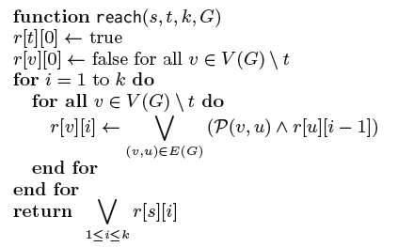
From 1 Path to M Paths
Problem: naïve enumeration of each path may need exponentially many paths
Solution: dynamic programming (a.k.a. loop unrolling)
Intermediate variables: “Can reach x in k hops?”
76

Slide 77



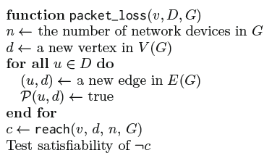


Blackhole
Black holes
lost
v
…
d₁
Ex: Generate Boolean expression to check whether there are packets originated from v but dropped without reaching any nodes of the destinations D in the network (assume no loop).
77

Slide 78









Offline Exercise
Boolean expressions to detect
u
…
w
Loop detection
u
Consistency
…
w
u’
78

Slide 79








Ex: Packet Transformation
Essential to model NAT, MPLS, QoS, etc.
dst_ip ∈
0.1.1.0/24
label = 5?
u
v
w
Solution
Model the history of packets: vector over time
Packet transformation ⇒ boolean constraints over adjacent packet versions
(p_{i}.dst ip ∈ 0.1.1.0/24) ^ (p_{i+1}.label = 5)
In general p_{i+1}= f (p_{i})
79

Slide 80
Anteater Success
Evaluated with UIUC campus network
～178 routers supporting >70,000 machines
Predominantly OSPF, also uses BGP and static routing 1,627 FIB entries per router (mean)
Result: Revealed 23 bugs with 3 invariants in 2 hours
 | Loop | Packet loss | Consistency
Being fixed | 9 | 0 | 0
Stale config. | 0 | 13 | 1
False pos. | 0 | 4 | 1
Total alerts | 9 | 17 | 2
80

Slide 81
Benefits of Anteater
First systematic application of Boolean logic to verify some common network properties
Many follow-up up applying SAT in particular and SMT (Satisfiability modulo theories) in general
Read SMT tutorial
Read Minesweeper on applying SMT to network verification
81

Slide 82
Outline
Recap
Layered architecture
what is layering?
why layering?
ISO/OSI layering and Internet layering
Network Verification
Data plane verification – Anteater
Control plane verification - Minesweeper
82

Slide 83
Control Plane Verification: Setting
Input: Each device has its configuration files (no data plane computed yet)
Output: Verify that the configurations will yield the a data plane that satisfies given correctness properties
83

Slide 84
Workflow
1.
Vendor-Specific Configs
2.
Vendor-Independent Format
Cisco
Arista
Interfaces: {
Ethernet0/0: {
InterfaceCost: 1,
importPolicy: “PEER_IN”,
…
}
}
Juniper
Parse
Encode
3.
4.
Output
Circuit Encoding
192.0.0.0 ≤ out.prefix
out.prefix ≤ 192.1.0.0
best.valid ⇒ out.lp = 120
best.valid ⇒ out.ad = 20
+ Property
Solve
Notes:
Idea: (4) useful counter-example OR verified property

Slide 85
Encoding Overview
‘‘
’’
Does P hold in the network?
N1
N2
N3
Network Encoding: N
S1
R1
R2
S2
⋀
Network Property: ¬ P
R3
Satisfiable: Property Violation
S3
Unsatisfiable: Holds for all data planes

Slide 86
Running Example
‘‘
Data plane packet
1
How does each router
forward a packet?
’’
N1
N2
N3
Symbolic Packet
{
}
0 ≤
dstIp
≤ 2³²
S1
R1
R2
S2
0 ≤
srcIp
≤ 2³²
0 ≤
dstPort
≤ 2¹⁶
???
???
0 ≤
srcPort
≤ 2¹⁶
R3
0 ≤
protocol
≤ 2⁸
S3
Notes:
At the end of the day, we care about how a packet is forwarded through the network.

Slide 87
Running Example
Protocol Interactions
2
N1
N2
N3
N1
N2
N3
Protocol
View
R1
R2
R1
R2
BGP
BGP
S1
S2
S1
CON
OSPF
OSPF
CON
S2
R3
R3
OSPF
CON
S3
S3

Slide 88
Running Example
Protocol Interactions
2
N1BGP
N1
N2
N3
Redistribution
From CON to BGP
BGP peering
Between R1 and R2
Circuit
View for R1
R1
R2
BGP
BGP
S1
CON
OSPF
OSPF
CON
S2
R1CON
R1BGP
R2BGP
R3
in4
e4
OSPF
CON
After R2
export filter
S3
R1OSPF
After R1
import filter
Notes:
Can a “routing record“ reach this point in a stable solution Define term. Black dots are routing records.

Slide 89
Running Example
Control Plane Info
3
N1BGP
Routing Record
valid:
1 bit
{
}
prefix:
[0,2³²)
prefixLen:
[0,2⁵)
R1CON
R1BGP
adminDist:
[0,2⁸)
localPref:
[0,2³²)
metric:
[0,2³²)
med:
[0,2³²)
ospfType
[0,2²)
R1OSPF

Slide 90
Running Example
R1 BGP import filter from R2
Import FIlters
4
ip prefix_list L deny 192.168.0.0/16 le 32
ip prefix_list L allow
route-map R1_Import_From_R2 10
match ip address prefix-list L
set local-preference 120
N1BGP
SMT constraint
If R2 exports a route
if e4.valid ∧ failedR1,R2 = 0 then if ¬ (FBM(e4.prefix, 192.168.0.0, 16) ∧
16 ≤ e4.prefixLen ≤ 32) then
in4.valid = true in4.lp = 120 in4.prefix = e4 .prefix
in4.metric = e4.metric
in4.prefixLen = e4 .prefixLen
…
else in4.valid = false
else in4 .valid = false
R1CON
If it passes the import filter
R1BGP
R2BGP
in4
e4
Then R1 has the same
route with local-pref 120
R1OSPF
Otherwise, R1 does not
have a route from R2

Slide 91
Running Example
Decision Process
5
N1BGP
What is the best BGP route?
R1-BGP-BEST = Min(in1, in4, in5, in7)
in1
in7
What is the best overall route?
R1CON
R1BGP
R2BGP
R1-BEST = Min(R1-BGP-BEST
in4
R1-OSPF-BEST
in5
R1-CON-BEST)
R1OSPF

Slide 92
Running Example
Decision Process
5
N1BGP
Does R1 have a RIB entry for R2?
RIB_{R1,R2} = (in4 = R1-Best)
R1CON
R1BGP
R2BGP
Does R1 have a FIB entry for R2?
e4
FIB_{R1,R2} = RIB_{R1,R2} ⋀ ¬ ACL(R1,R2)
in4
R1OSPF

Slide 93
Supported Features
Features
Implemented
Continued…
OSPF Intra-area
iBGP
OSPF Inter-area
Route Reflectors
eBGP Local-pref
Static Routes
eBGP Communities
Route Redistribution
eBGP MEDs
Multipath Routing
eBGP Path Prepending
Access Control Lists
eBGP Aggregation
IPV6

Slide 94
Property: Reachability / Isolation
‘‘
’’
Can router R3 (not) reach subnet S2?
N1
N2
N3
canReach_{R2} ⇔ FIB_{R2,S2}
canReach_{R1} ⇔
(FIB_{R1,R2} ⋀ canReach_{R2}) ⋁
(FIB_{R1,R3} ⋀ canReach_{R3})
S1
R1
R2
S2
canReach_{R3} ⇔
(FIB_{R3,R1} ⋀ canReach_{R1})
R3
Property: canReach_{R3}
S3
Notes:
Emphasize, reachability here is for all possible data planes

Slide 95
Supported Properties
Reachability
Waypointing
Isolation
Path Length
2
1
0

Slide 96
Supported Properties
Disjoint Paths
Black Holes
Forwarding Loops
Multipath Consistency
D
S

Slide 97
Supported Properties
Load Balancing
Fault-Invariance
.4
.6
Router Equivalence
Network Equivalence
=

Slide 98
Evaluation
Can Minesweeper find real bugs?
Run on a collection of 152 legacy networks
1—23K lines of configuration
Use OSPF, eBGP, iBGP, Static Routes, ACLs, Redistribution
How well does Minesweeper scale?
Test on a collection of synthetic data center benchmarks
Compare verification time across a wide variety of properties

Slide 99
Evaluation: Bug Finding
Mangement interface reachability
Loopback0
Found 67 violations of the property
Example: BGP peer sends /32 with length 2
Local equivalence of routers
Found 29 violations
Example: ACL has missing entry
Blackholes occur only at the network edge
Found 24 violations of the property
Reachability is the same after any 1 failure
Found no violations of the property

Slide 100
Evaluation: Scalability
Management interface reachability
< 60 ms
Local equivalence of routers
(For all n comparisons)
< 400 ms

Slide 101
Evaluation: Scalability
Black holes only occur
at the network edge
< 1.5 sec
Reachability is the same after
any single link failure
< 350 ms

Slide 102
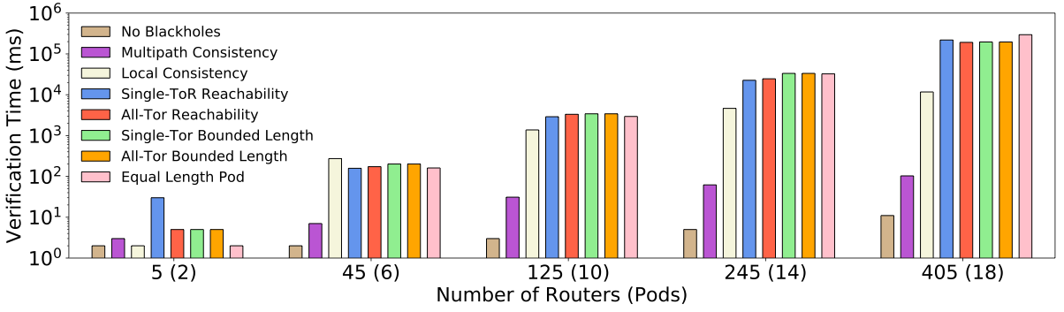
Evaluation: Scalability
< 5 minutes

Slide 103
Discussion
Limitations of modeling using only SAT/SMT?
103

Slide 104
Thanks
Instructor: Qiao Xiang
Contact: qiaoxiang@xmu.edu.cn

